Slide 1
Arkanoid
Anisimov Kirill 23214
Lebedev Nikolai 23214 Romankin Daniil 23214

Slide 2
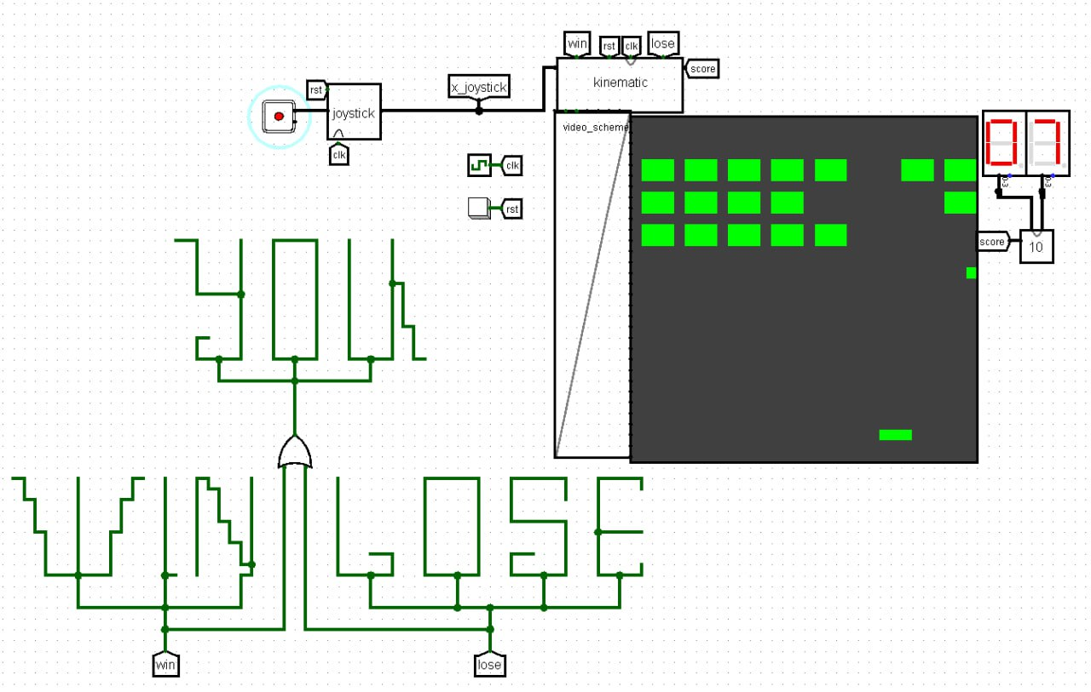
Introduction
Arkanoid is a classic arcade game in which the player controls a platform, hitting a ball and destroying blocks on the screen. The goal is to clear all the blocks from the field without letting the ball fall. The game ends when a player reaches 72 points (win) or when the ball reaches the bottom of the screen (lose). Our version of Arkanoid is a simplified variant of the original game.

Slide 3
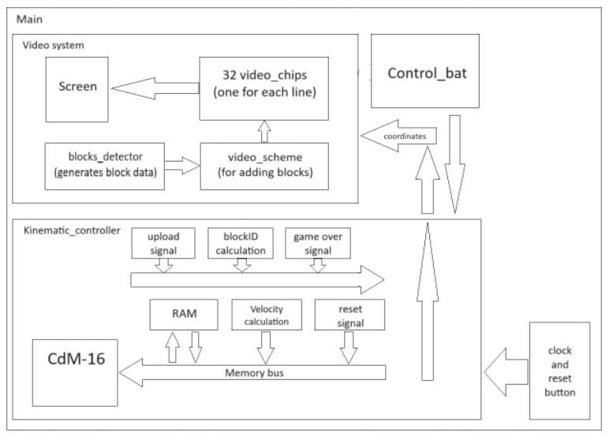
Hardware

Slide 4
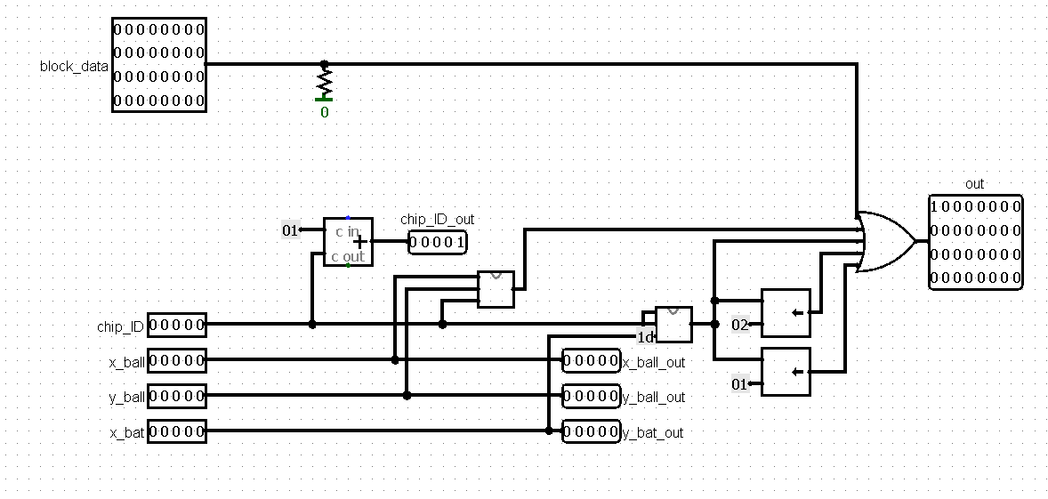
Video chip

Slide 5
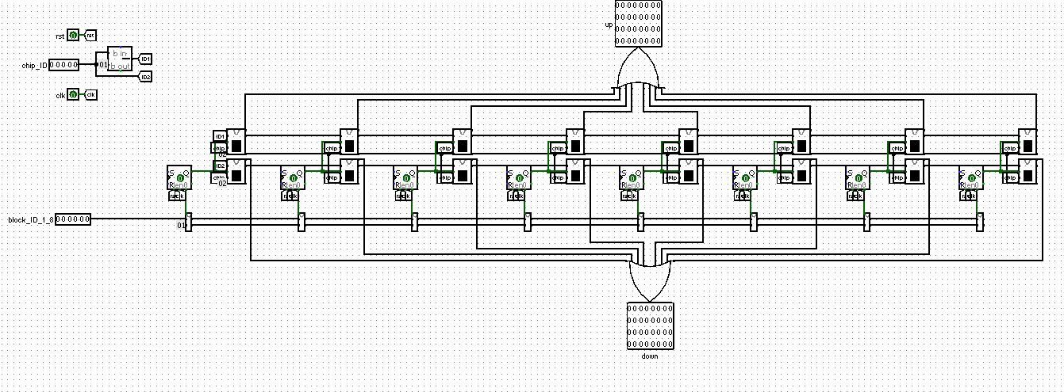
Block detector

Slide 6
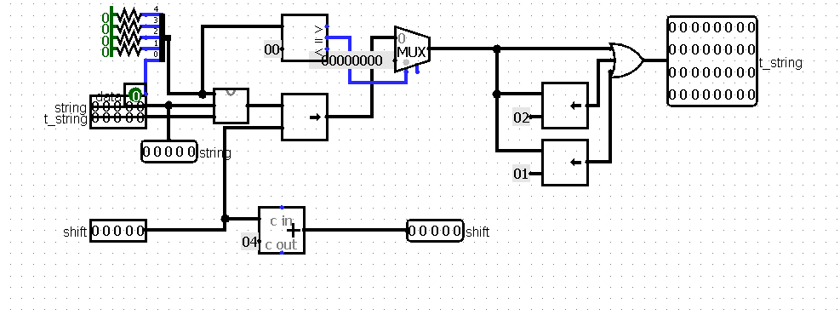
Block paint

Slide 7
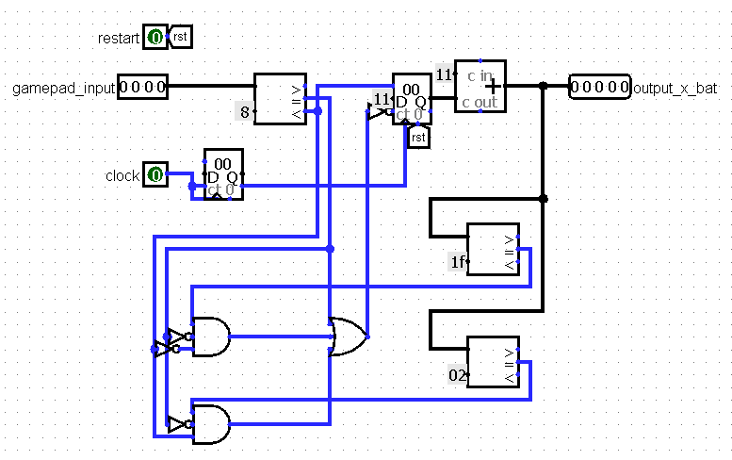
Bat control

Slide 8
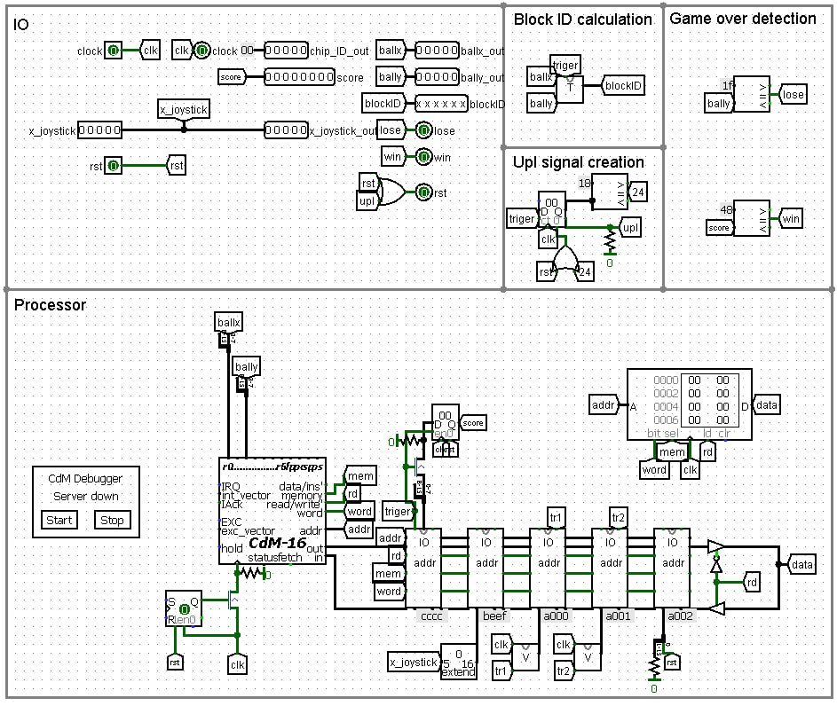
Kinematic controller

Slide 9
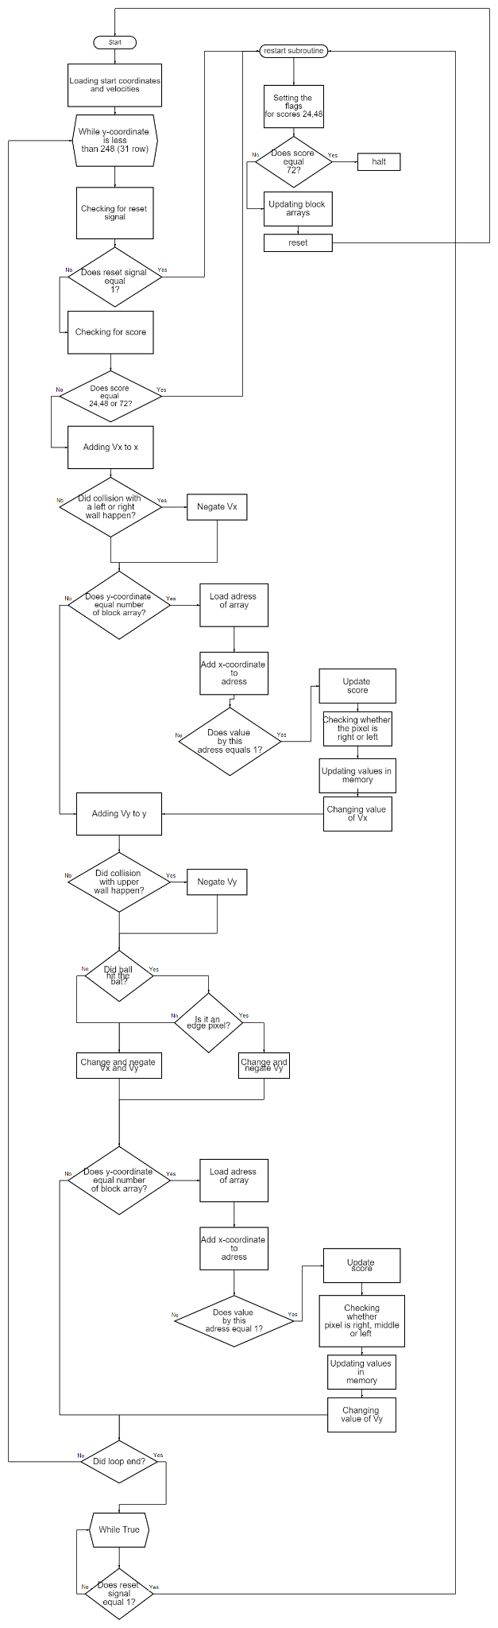
Software

Slide 13
Conclusion
For our team, the project work has been very interesting. We have gained a significant amount of experience through working in a collaborative environment, writing assembly code, designing chips, and creating documentation.

